Slide 1
TRAFFIC MANAGEMENT

Slide 2
Table of contents
● INTRODUCTION
● CONDN
● COMPONENTS USED
● WORKING PRINCIPEL
● BLOCK DIAGRAM

Slide 3
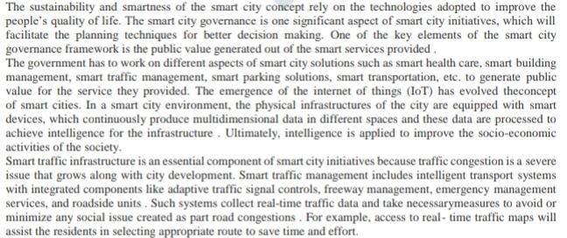
INTRODUCTION

Slide 4
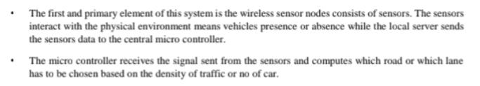
CONDN

Slide 5
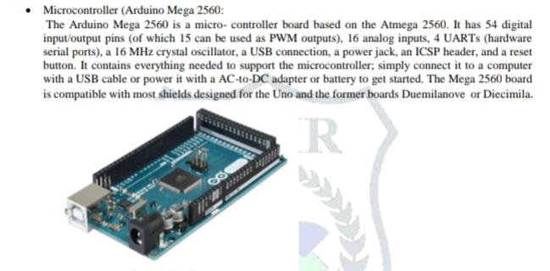
COMPONENTS USED

Slide 6
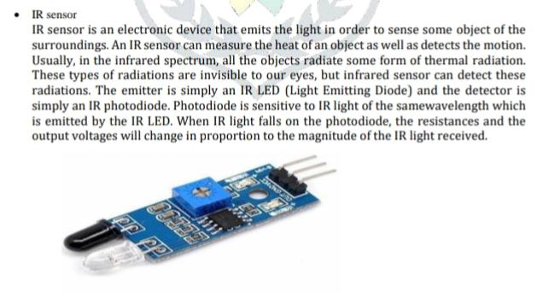

Slide 7
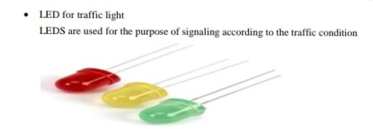

Slide 8
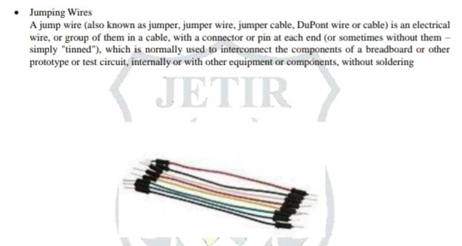

Slide 9
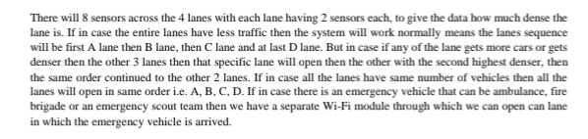
WORKING PRINCIPEL

Slide 10
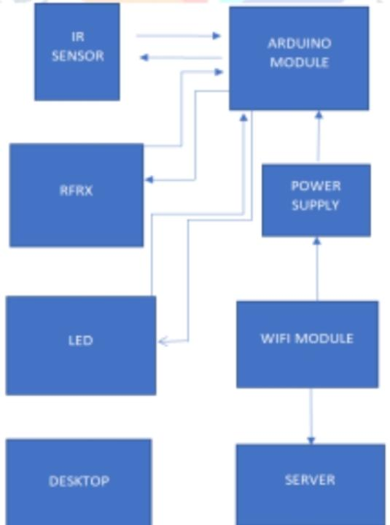
BLOCK DIAGRAM

